Slide 1
Hotels in Madison Area
Hangyu Kang, Xiangyu Wang, Ruyan Zhou

Slide 2
Data Cleaning Process
Merge review_city.json to business_city.json according to the corresponding business id
Select out the row according to the categories that contains hotels
Select out the row according to the business name that contains hotel, inn, Hilton, Courtyard, Edge, Place, Graduate, Wyndham, Suites, Motel, Lodge
Select out city = Madison, and drop the city and state column

Slide 3
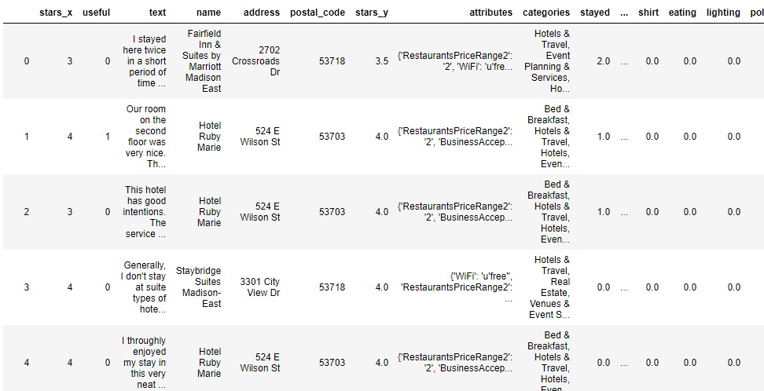
Data Cleaning Process
Drop all columns except rated star, review text, name, address, postal code, average rates, attributes of businesses, categories of business.
Break the review text into word by word, get rid of stop words and special characters and make it into matrix form.
Combine it to the original dataset

Slide 4
Data Analysis Process (Manipulating Cleaned Dataset)
1532 x 1405
1532 rows => reviews about hotels in Madison
1395 columns => Word Frequency
10 columns => About business

Slide 5
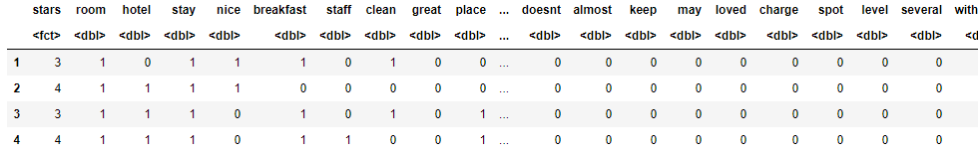
Data Analysis Process (Manipulating Cleaned Dataset)
1532 x 1405
1532 x 344

Slide 6
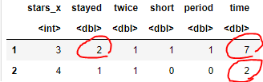
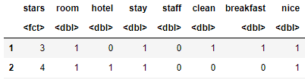
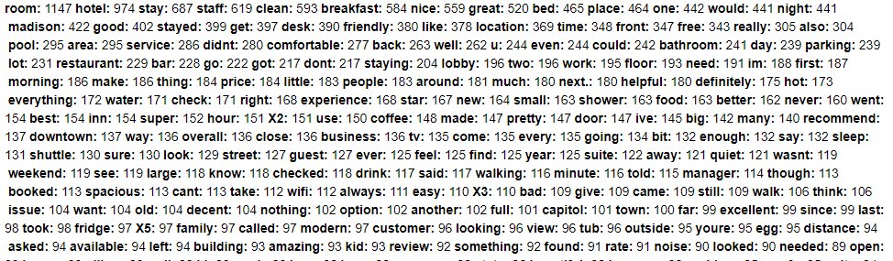

Data Analysis Process (Manipulating Cleaned Dataset)
1532 x 1405
1532 x 344
First, we reduced the overlapping count to 1
Second, we excluded unmeaningful words, by selecting out the words more used than 3rd quantile(53.00)

Slide 7
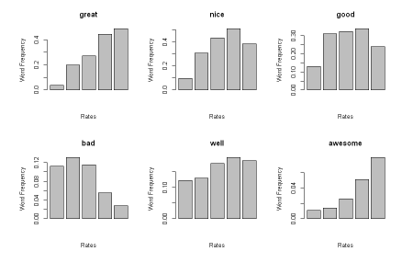
Data Analysis Process (Exploratory Data Analysis)
1. Words associated with service and furniture
Staff, service, manager, reservation, breakfast, coffee, drink, price, suite, bed, desk, wifi, tv, fridge, pillow, towel, booked, food, microwave, dinner, money, fruit, buffet, beer
2. Words associated with facility
Room, bathroom, pool, tub, shower, lobby, elevator, wall, parking, gym, amenity, size, light, car
3. Words associated with location
Shuttle, downtown, airport, distance, bar, location, restaurant, park, near, club
4. Words associated with atmosphere of hotels
Family, kid, business, clean, comfortable, small, pretty, quiet, beautiful, spacious, modern, noise, smell, comfy, week, weekend, dirty

Slide 8
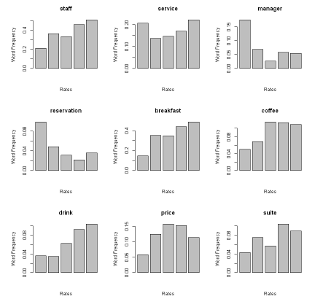
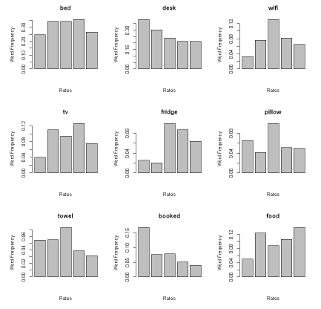
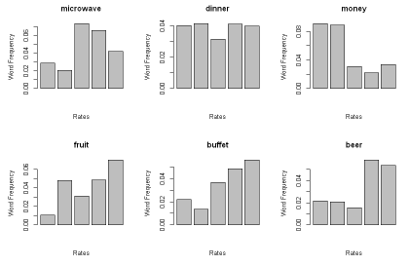
Data Analysis Process (EDA)
1. Words associated with service and furniture
Staff, service, manager, reservation, breakfast, coffee, drink, price, suite, bed, desk, wifi, tv, fridge, pillow, towel, booked, food, microwave, dinner, money, fruit, buffet, beer

Slide 9
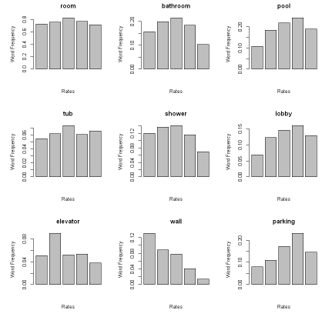
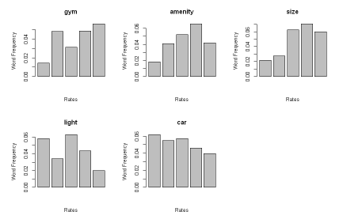
Data Analysis Process (EDA)
2. Words associated with facility
Room, bathroom, pool, tub, shower, lobby, elevator, wall, parking, gym, amenity, size, light, car

Slide 10
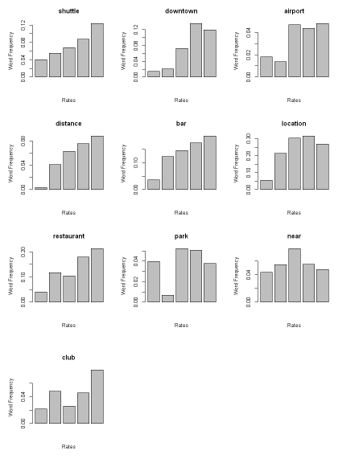
Data Analysis Process (EDA)
3. Words associated with location
Shuttle, downtown, airport, distance, bar, location, restaurant, park, near, club

Slide 11
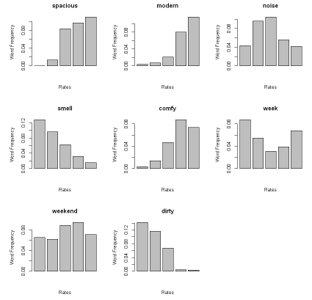
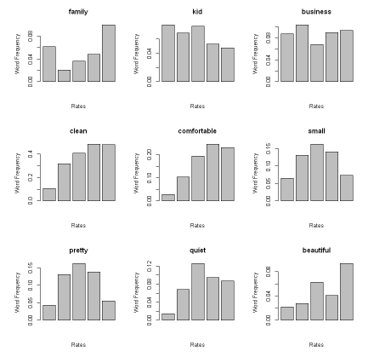
Data Analysis Process (EDA)
4. Words associated with atmosphere of hotels
Family, kid, business, clean, comfortable, small, pretty, quiet, beautiful, spacious, modern, noise, smell, comfy, week, weekend, dirty

Slide 12

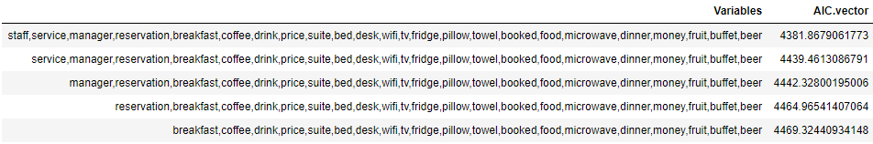
Statistical Test For the Chosen Words
Separate Word Embedding Dataset into 4 Datasets
1. Multinomial Logistic Regression
2. Backward AIC
Select out influential words for determining star rating

Slide 13
SELECTED Words
1. Words Associated With Service
Staff, Manager, Breakfast, Booked, Money, and Desk
2. Words Associated With Facility
Wall and Parking
3. Words Associated With Location
Restaurant, Downtown, Bar and Location
4. Words Associated With Atmosphere
Modern, Clean, Pretty, Comfortable, Spacious, Quiet, Comfy, Smell and Dirty

Slide 14

What Makes Differences Between Low Rated Hotels and High Rated Hotels?
How to determine low rated and high rated hotels?
Average rates > 3.5 (Median of Average Rate) => High Rated Hotels
Average rates < 3.5 => Low Rated Hotels
Low Rated Hotel
22 Hotels
567 Reviews
High Rated Hotel
23 Hotels
965 Reviews

Slide 15
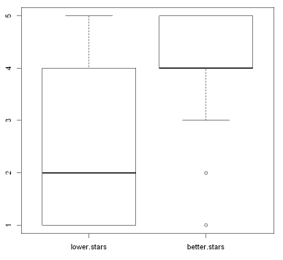
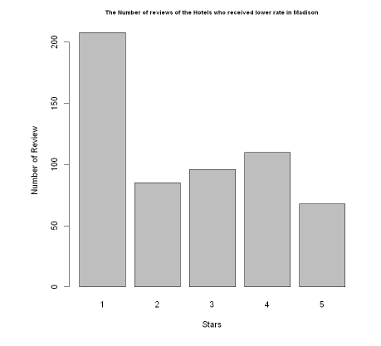
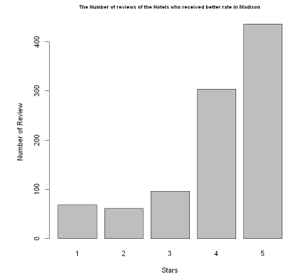
What Makes Differences Between Low Rated Hotels and High Rated Hotels?
Low Rated Hotels
High Rated Hotels

Slide 16
SELECTED Words
1. Words Associated With Service
Staff, Manager, Breakfast, Booked, Money, and Desk
2. Words Associated With Facility
Wall, Parking and Toilet
3. Words Associated With Location
Restaurant, Downtown, Bar and Location
4. Words Associated With Atmosphere
Modern, Clean, Pretty, Comfortable, Spacious, Quiet, Comfy, Smell and Dirty

Slide 17
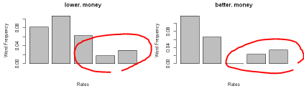
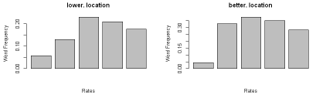
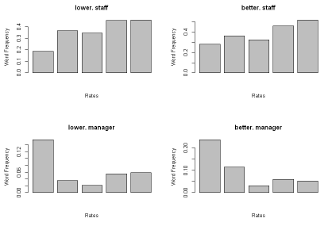
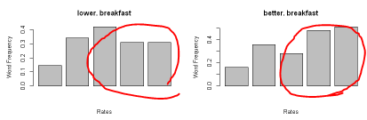
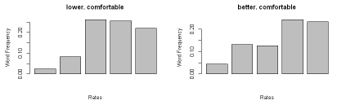
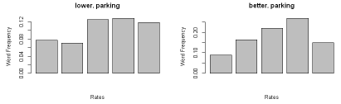
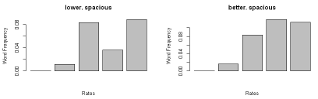
The words that makes difference
Money, breakfast, parking, location, comfortable, spacious

Slide 18
The words that makes difference
Money, breakfast, parking, location, comfortable, spacious
Proportion Test P-values
Star | 3 | 4 | 5
Money | 0.03809 | 1 | 1
Breakfast | 0.06923 | 0.002298 | 0.002886
Parking | 0.1259 | 0.004478 | 0.6172
Location | 0.04102 | 0.008122 | 0.09249
Comfortable | 0.02812 | 0.8634 | 0.9627
Spacious | 1 | 0.021 | 0.7003
p-val < 0.05
There is significant difference

Slide 19
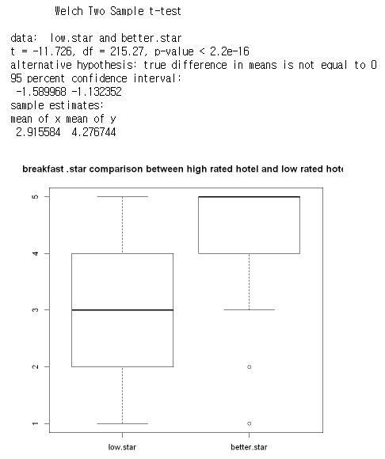
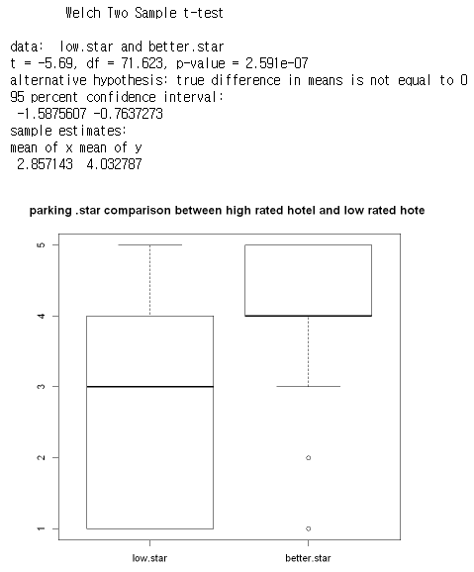
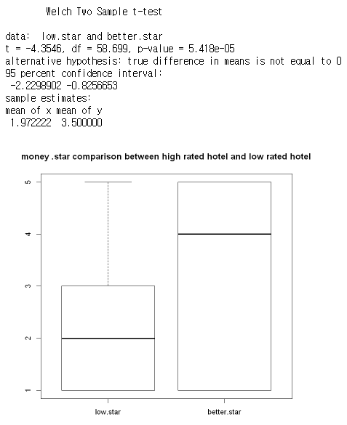
The words that makes difference
Breakfast
Parking
Money

Slide 20
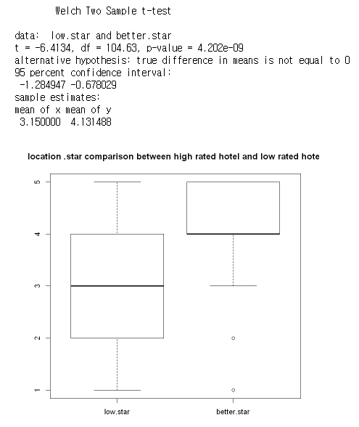
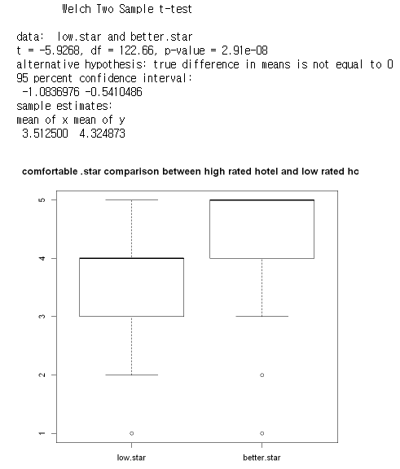
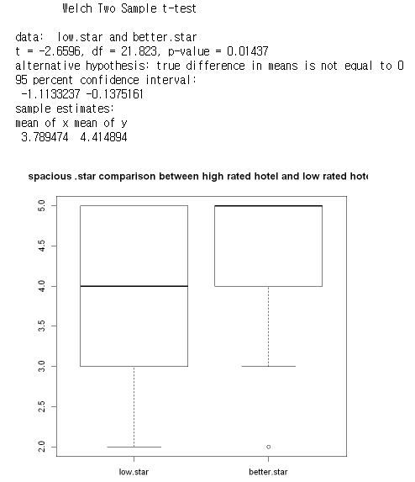
The words that makes difference
Location
Comfortable
Spacious

Slide 21
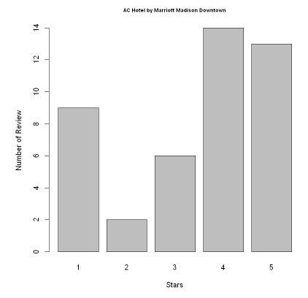
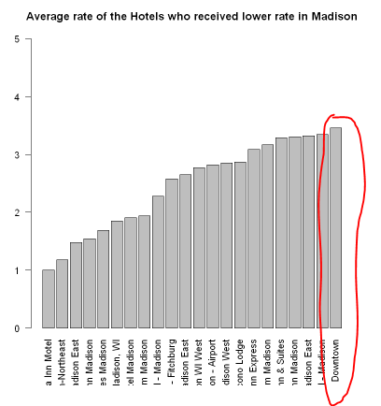
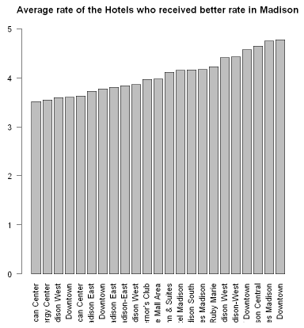
About AC hotel by Marriott in downtown madison
Average Rate : 3.4545 ≈ 3.46
44 Reviews

Slide 22
How to achieve improvement?
1. Words Associated With Service
Staff, Manager, Breakfast, Booked, Money, and Desk
2. Words Associated With Facility
Wall and Parking
3. Words Associated With Location
Restaurant, Downtown, Bar and Location
4. Words Associated With Atmosphere
Modern, Clean, Pretty, Comfortable, Spacious, Quiet, Comfy, Smell and Dirty

Slide 23
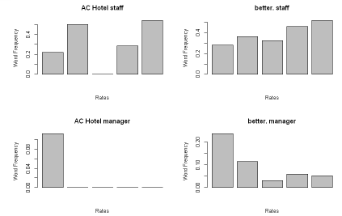
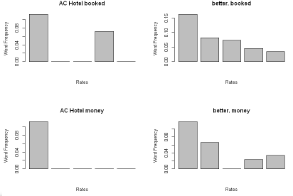
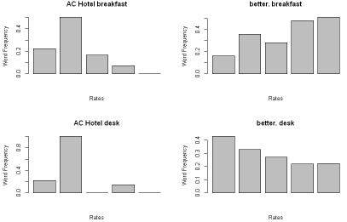
How to achieve improvement?
1. Words Associated With Service
Staff, Manager, Breakfast, Booked, Money, and Desk

Slide 24
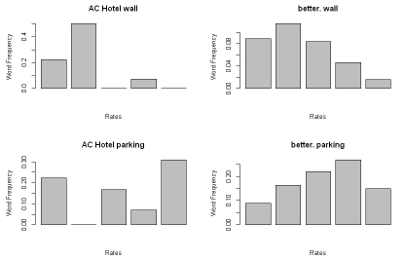
How to achieve improvement?
2. Words Associated With Facility
Wall and Parking

Slide 25
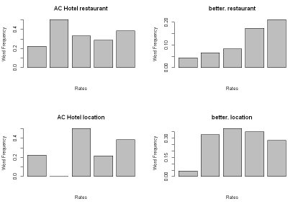
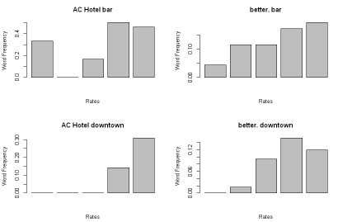
How to achieve improvement?
3. Words Associated With Location
Restaurant, Downtown, Bar and Location

Slide 26
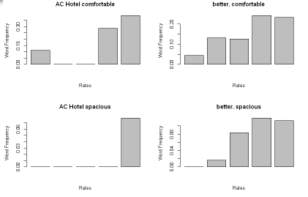
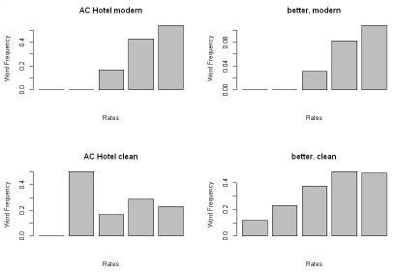
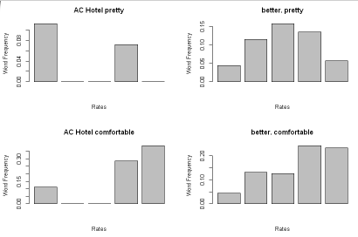
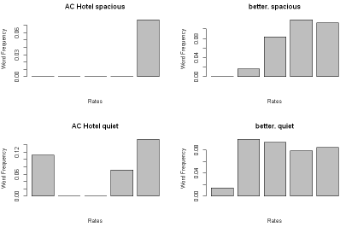
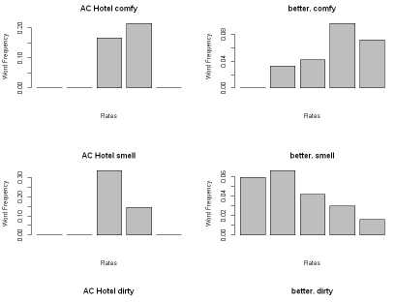
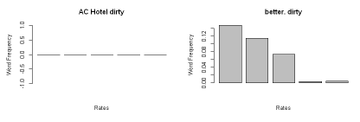
How to achieve improvement?
4. Words Associated With Atmosphere
Modern, Clean, Pretty, Comfortable, Spacious, Quiet, Comfy, Smell and Dirty

Slide 27
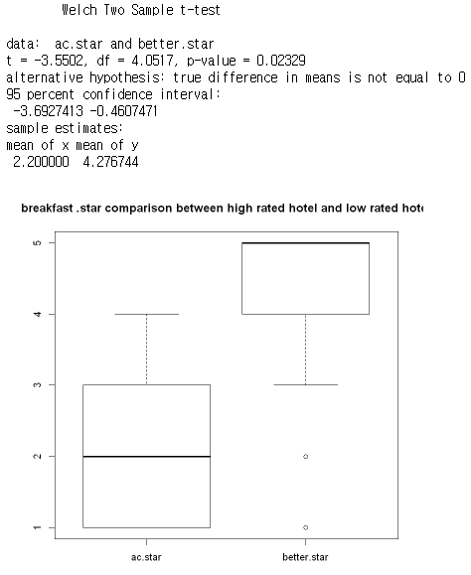
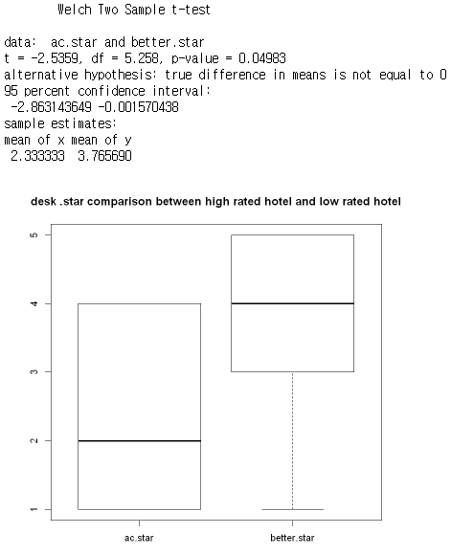
How to achieve improvement?
Breakfast
Desk

